Slide 1
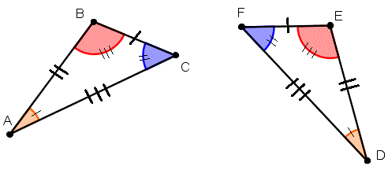
My Geometry Interactive Notebook
Name:
Class: 9-5
Teacher: Miss L
Term 2 Semester 1

Slide 2
24
7
30
Topic: Congruent Triangles
Date
EQ - How do we know if two triangles are congruent?
Last Lesson Recap
What is Congruent Shapes?
Congruent shapes have the same shape and size. They can fit exactly on top of each other.

Slide 3
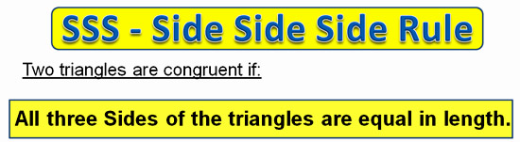
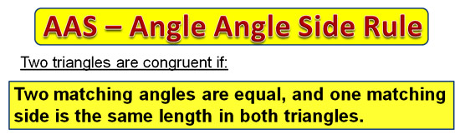
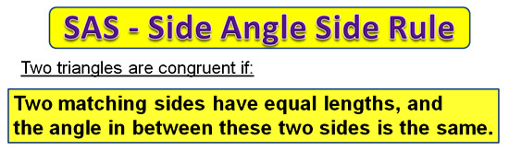
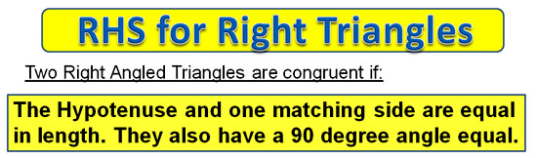
24
7
30
Topic: Tests for Congruent Triangles
Date
EQ - How do we test for congruency?

Slide 4
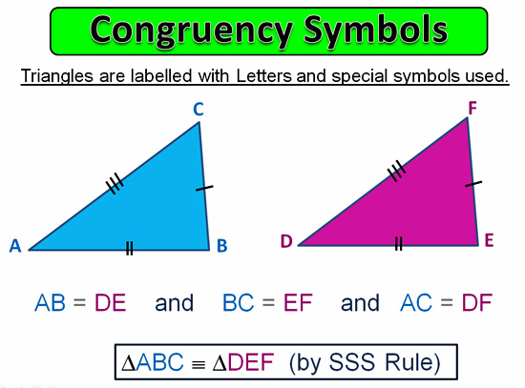

Slide 5
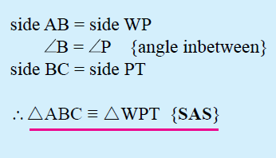
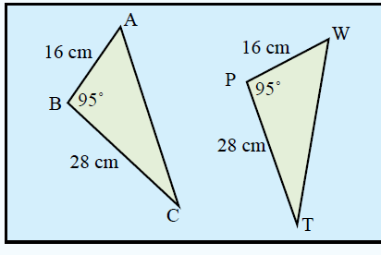
24
7
30
Topic: Tests for Congruent Triangles
Date
EQ - How do we test for congruency?

Slide 6
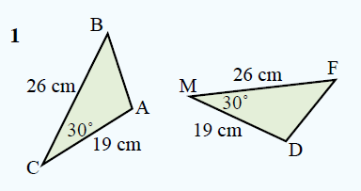
24
7
30
Topic: Tests for Congruent Triangles
Date
EQ - How do we test for congruency?

Slide 7
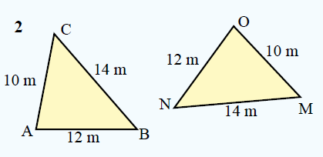
24
7
30
Topic: Tests for Congruent Triangles
Date
EQ - How do we test for congruency?

Slide 8
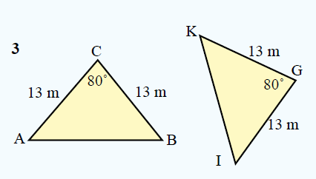
24
7
30
Topic: Tests for Congruent Triangles
Date
EQ - How do we test for congruency?

Slide 9
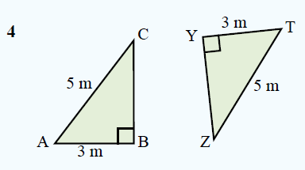
24
7
30
Topic: Tests for Congruent Triangles
Date
EQ - How do we test for congruency?

Slide 10
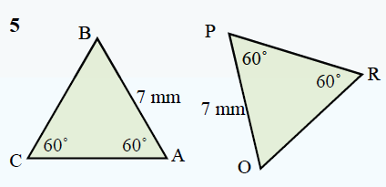
24
7
30
Topic: Tests for Congruent Triangles
Date
EQ - How do we test for congruency?

Slide 11
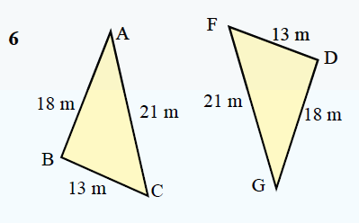
24
7
30
Topic: Tests for Congruent Triangles
Date
EQ - How do we test for congruency?

